Slide 1
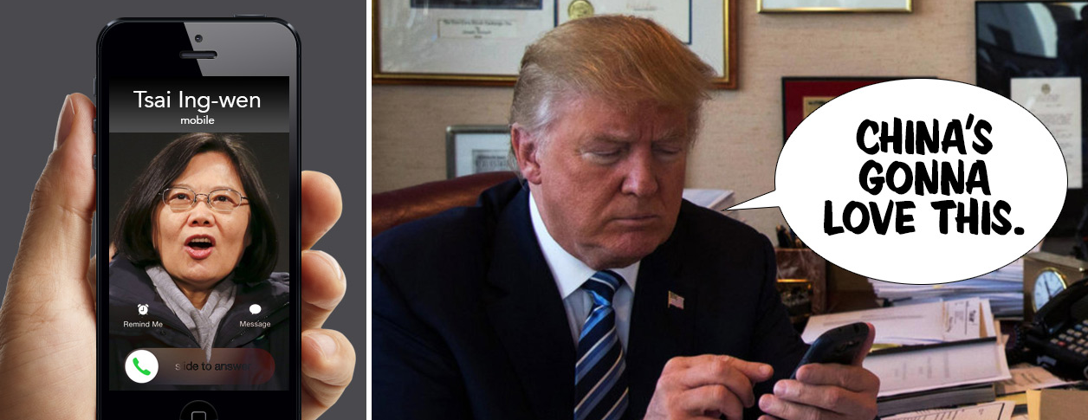
Trump's Taiwan Call What are people tweeting regarding Trump’s Taiwan call ? Dataset Pitch (Team 4)
趙上涵 Ricardo S. Chao
楊曜丞 Dylan Yang
趙晟瑋 Spencer Chao

Slide 2
Outline
Noise estimating & Data splitting
Problem Domain
Data Overview
Data representation
Interpretation
Modeling
Conclusion
Conclusion

Slide 3
Problem Domain
Noise eliminating & Data splitting
Problem Domain
Data Overview
Data representation
Interpretation
Modeling
Conclusion
Conclusion

Slide 4
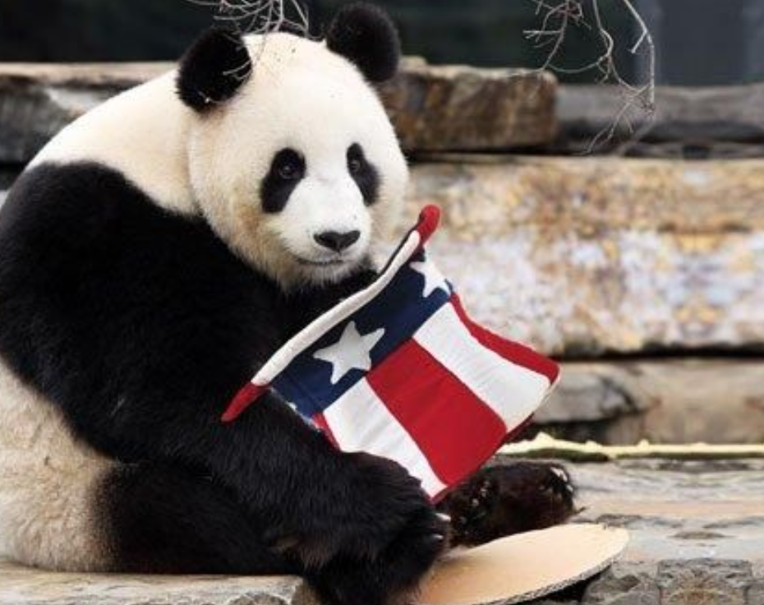
PROBLEM DOMAIN: Issue
“We are curious about the political tendency of each tweet. Could we classify all the tweets into different groups with different political tendencies?”
Pro-Trump
Anti-Trump

Slide 5
PROBLEM DOMAIN: Goal
“To resolve the issue, our main goal is to apply unsupervised algorithm we’ve learned to our dataset (tweets) with tools manufactured by ourselves and with mathematical concept in our mind.”
Mathematical Concepts
More Handmade Models
Natural Language Processing Techniques

Slide 6
Data Overview
Noise eliminating & Data splitting
Problem Domain
Data Overview
Data representation
Interpretation
Modeling
Conclusion
Conclusion

Slide 7

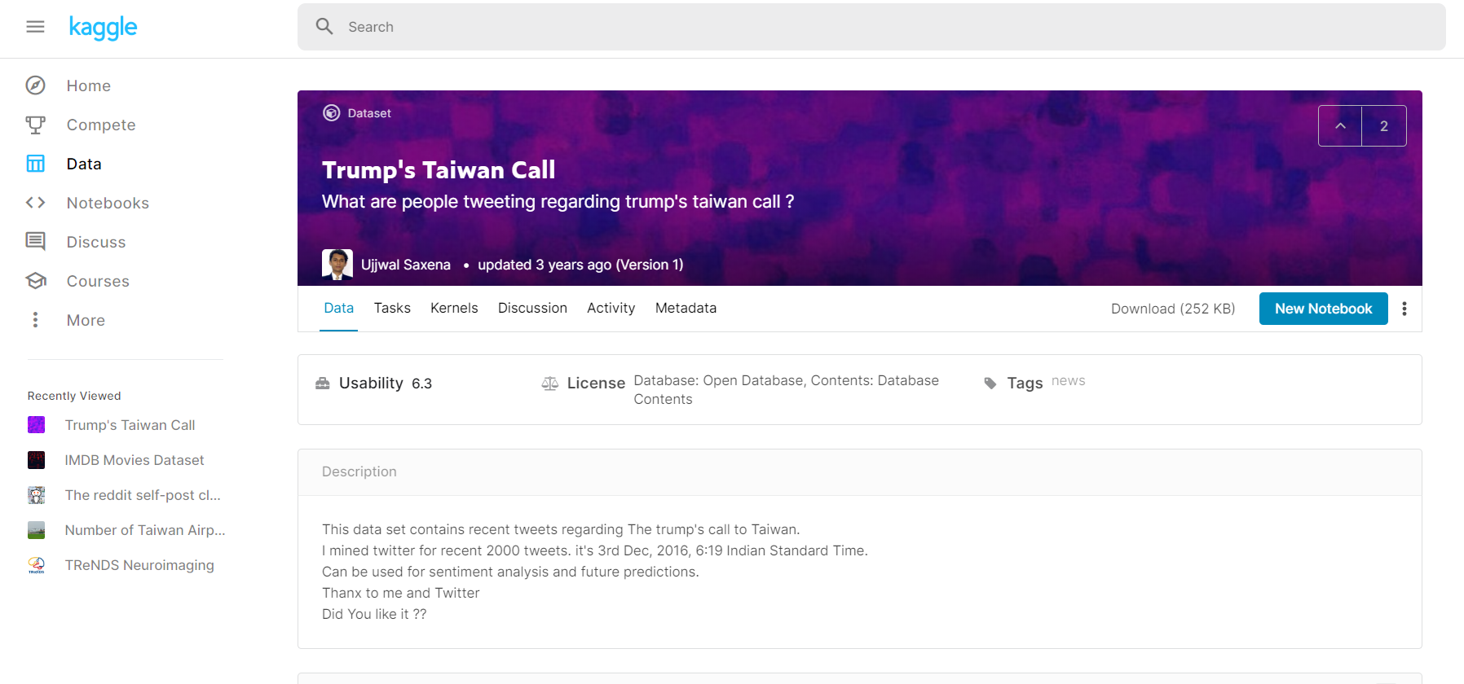
Dataset Overview

Slide 8

Dataset Overview
TWEETS
RT @SteveSGoddard: The @nytimes was thrilled by Obama talking to Communist dictator Castro, and horrified by Trump talking to the elected l??e
Oops. RT @thehill: Trump breaks decades of US protocol with phone call to Taiwan leader https://t.co/YU2x04PhV7 https://t.co/2WXDViC7lK
Donald Trump? call with Taiwan president was no surprise: Official https://t.co/F8TzF1U9UPps
RT @ShubieDobee: So, Trump spoke to the president of Taiwan.
Trumps wants to build hotel and resorts in Taiwan.
Does anyone see a CONFLICT???n
Same mental midgets that defended Castro https://t.co/Nrt2yCb7M0 are mad Trump talked to Taiwan
RT @guardian: Trump's Taiwan phone call preceded by hotel development inquiry https://t.co/nqKTBVr3eK
RT @laseptiemewilay: 1-About Trump's phone call to Taiwan's. First, it's a major diplomatic incident. Second, as part of the US normalizati??e
Trump Speaks With Taiwan? Leader, an Affront to China https://t.co/AEeTzcpNS7 #SouthChinaSea #AsiaPacificnd
RT @RawStory: REVEALED: Trump Organization eyes Taiwan for newest luxury resort location https://t.co/RuaFG6YTub https://t.co/je0TE0LXbE
RT @terrymendozer: Obama will not release info to congress on refugees deal and y'all worried about a congratulatory call from our ally Tai??e
RT @thehill: Trump says Taiwan leader called him, though Taiwan paper says Trump staffer arranged call https://t.co/QYprHM5BLs https://t.co??e
RT @_Makada_: Hoaxing media says Trump isn't allowed to talk to Taiwan, but Obama can sell them $1.83 billion worth of weapons?
https://t.??:
RT @kurteichenwald: I wonder how conservs will respond to Trump having just reversed a China/Taiwan policy put in place by Reagan &amp; honored??
RT @realwesmyers: Can you believe Donald Trump took a call from Taiwan without having them donate to his private foundation first?
RT @terrymendozer: Obama will not release info to congress on refugees deal and y'all worried about a congratulatory call from our ally Tai??e
@MarkJKremer @realDonaldTrump MSM continues to lie lie lie. Taiwan called Trump. He didn't call Taiwan.
RT @EricLiptonNYT: Trump Org: "we are not planning any expansion into Taiwan." How abt this? Great find @mega2e https://t.co/zBLAHLeJmz htt??e

Slide 9
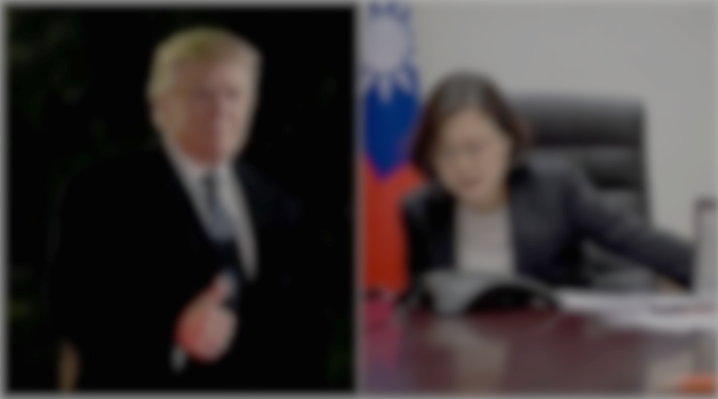
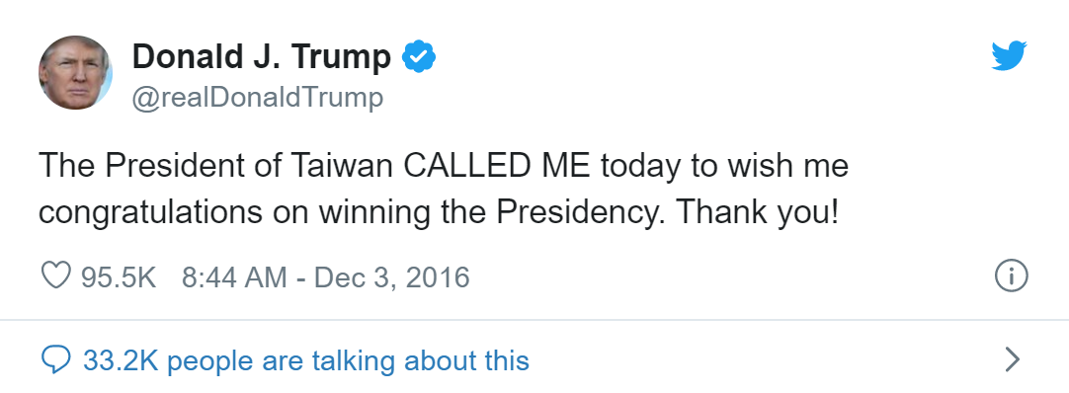
Dataset Overview
Trump's phone call with Taiwan president risks China's wrath
The Guardian | Sat 3 Dec 2016 10.19 GMT | https://reurl.cc/Y14aoL
Donald Trump looked to have sparked a potentially damaging diplomatic row with China on Friday after speaking to Taiwanese president Tsai Ing-wen on the telephone in a move experts said would anger Beijing.
The call, first reported by the Taipei Times and confirmed by the Financial Times, is thought to be the first between the leader of the island and a US president or president-elect since ties between America and Taiwan were severed in 1979, at Beijing’s behest.

Slide 10


Dataset Overview
RT @SteveSGoddard: The @nytimes was thrilled by Obama talking to Communist dictator Castro, and horrified by Trump talking to the elected l??e
Kate is donating a #kidney to her husband http://t.co/Xg95n9tFkE . You can help! I did @fundanything #donate
Retweet Without Comment
@Canvasguru: Lol! RT @martintagg: .@realDonaldTrump You've been popular with ladies for a while. What's your secret handsome?" My hair!
Tweet
Retweet With Comment

Slide 11
Dataset Overview
Tweet Type
At Sign
Retweet Text
RT @SteveSGoddard: The @nytimes was thrilled by Obama talking to Communist dictator Castro, and horrified by Trump talking to the elected l??e
Tweet Content
Link
Kate is donating a #kidney to her husband http://t.co/Xg95n9tFkE . You can help! I did @fundanything #donate
Retweet Without Comment
Hashtag
Personal Comment
@Canvasguru: Lol! RT @martintagg: .@realDonaldTrump You've been popular with ladies for a while. What's your secret handsome? My hair!
Tweet
Retweet With Comment

Slide 12
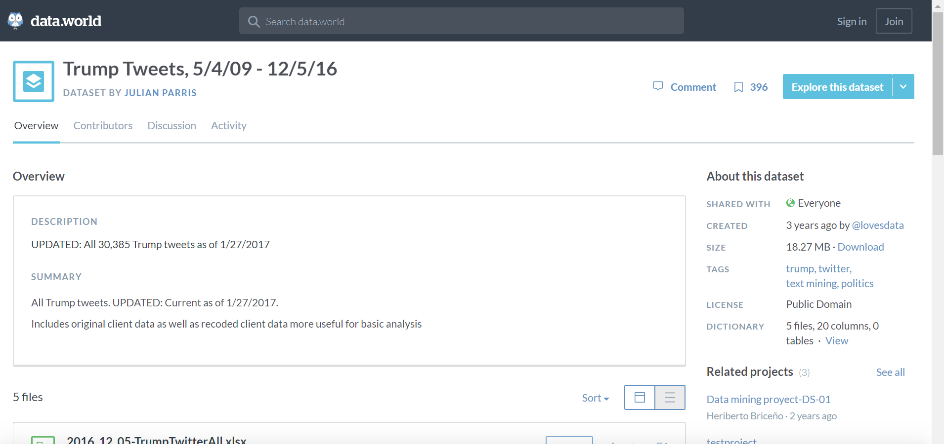

Slide 13
Dataset Overview
610 retweet data and 30692 original data
.csv file (each row represent an entry of the data.)
Include various “Twitter Slangs”, such as @ Sign, Hashtag , RT, etc.
Lots of noise, and misspellings.
Without labels.

Slide 14
Dataset Overview
Mojibake
Donald Trump?雓?call with Taiwan president was no surprise: Official https://t.co/F8TzF1U9UPps
RT @charliekirk11: Trump takes a congratulatory phone call from Taiwan and gets from grief from the media than Obama giving $500 billion to??e
RT @terrymendozer: Obama will not release info to congress on refugees deal and y'all worried about a congratulatory call from our ally Tai??e
Misspelling
Misspelling
→ Before applying models, noise should be eliminated.

Slide 15
Noise eliminating & Data splitting
Noise eliminating & Data splitting
Problem Domain
Data Overview
Data representation
Interpretation
Modeling
Conclusion
Conclusion

Slide 16
Purpose
Noise eliminating
Data splitting
To make sure that only the important part of the corpora are fed into the models and ensure the accuracy of the result.
To split the important content of the tweet into individual vocabularies and input into the model.
Notes:
https://books.google.com.tw/books?id=HxmdDwAAQBAJ&pg=PA11&lpg=PA11&dq=Noise+Removal+natural+language&source=bl&ots=lQEYvoC4VW&sig=ACfU3U2KBAzXS_KJ1cZBhyyTE29hYzvkWw&hl=zh-TW&sa=X&ved=2ahUKEwigkNGy5oLqAhUsK6YKHU4CCrsQ6AEwA3oECAgQAQ#v=onepage&q=Noise%20Removal%20natural%20language&f=false

Slide 17
Noise eliminating
To make sure that only the important part of the corpora are fed into the models and ensure the accuracy of the result. We had defined the noises:
Mojibake
Stop Words
Lowercase
Donald Trump?雓?call with Taiwan president was no surprise: Official https://t.co/F8TzF1U9UPps to??e #donate
Punctuation
donald call taiwan surprise official
Link
Misspelling
Notes:
https://books.google.com.tw/books?id=HxmdDwAAQBAJ&pg=PA11&lpg=PA11&dq=Noise+Removal+natural+language&source=bl&ots=lQEYvoC4VW&sig=ACfU3U2KBAzXS_KJ1cZBhyyTE29hYzvkWw&hl=zh-TW&sa=X&ved=2ahUKEwigkNGy5oLqAhUsK6YKHU4CCrsQ6AEwA3oECAgQAQ#v=onepage&q=Noise%20Removal%20natural%20language&f=false

Slide 18
Data splitting
To split the important content of the tweet into individual elements and input to the model.
Donald Trump?雓?call with Taiwan president was no surprise: Official https://t.co/F8TzF1U9UPps to??e #donate
donald call taiwan surprise official
donald
call
taiwan
surprise
official

Slide 19
Data splitting
is_RT | retweet_from | stopwords_removed_original_text
0 |  | mysticwolf12001 cmon one beating clinton
0 |  | chadwilliams91 ill move states you are hired thanks
0 |  | hunterbalthazor ran president vote back track
0 |  | kyleraccio vinnytitone think hell lead polls like healthy trump
0 |  | harrycraig96
0 |  | americanwoman00 great greta awesome thank you
0 |  | people proud fact obama birth certificate book miraculously
0 |  | garrykennedy great greta huge fan really inspire me thank you
0 |  | carlotalorenabr fact realdonaldtrump run excited
1 | DanScavino | join amp vpeotus pence live west allis wisconsin thankyoutour2016
1 | DanScavino | join live mobile alabama via thankyoutour2016 watch
1 |  | importing homeland agree mr trump
1 | realDonaldTrump | happy
1 | Reince | happy year blessings all looking forward things 2017 realdonaldtrump
1 | IvankaTrump | 2016 one exciting years life wish peace love happy new
1 | jamestaranto | serious people worry start war trump phone taiwans crazy oe
1 |  | photos show public
1 | DanScavino | one think photo says all
1 | King_Pepp | driving tons ugly realdonaldtrump talking
1 | realDonaldTrump | secret getting getting started twain

Slide 20
Data representation
Noise eliminating & Data splitting
Problem Domain
Data Overview
Data representation
Interpretation
Modeling
Conclusion
Conclusion

Slide 21
Vector Space model
Since the content of tweets is mostly unstructured, the Vector Space model must be used to convert it into structured data and obtain useful information.
BOW (Bag of word)
WORD2Vec

Slide 22

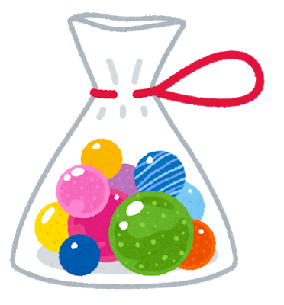
BOW (Bag of Words)
BOW is a common representation of documents. The representation of a document d is the set of weight of its term.
Mary is quicker than John.
Sentence | Mary | John | Alex | quicker
Mary is quicker than John. | 1 | 1 | 0 | 1
John is quicker than Alex. | 0 | 1 | 1 | 1
John is quicker than Alex.

Slide 23
BOW (Bag of Words)
BOW is a common representation of documents. The representation of a document d is the set of weight of its term.
[CONS. 1] The Ordering of the terms is ignored!!!
Mary is quicker than John.
Sentence | Mary | John | Alex | quicker
Mary is quicker than John. | 1 | 1 | 0 | 1
John is quicker than Mary. | 1 | 1 | 0 | 1
[CONS. 2] If most of the feature vectors are sparse, bag-of-words feature matrix would be a sparse matrix!!!
John is quicker than Mary.

Slide 24
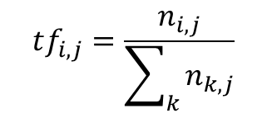
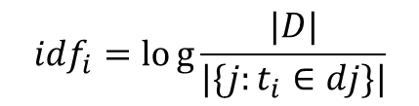
TF-IDF
TF-IDF (Term Frequency-Inverse Document Frequency) is an unsupervised learning algorithm and a statistical method that often be used to evaluate how important a word is to whole data. TF-IDF Keyword extraction is commonly used as a weighted method of information retrieval and text exploration.
TF
IDF
$$tf_{i,j}=\frac{n_{i,j}}{\sum_{k}{n_{k,j}}}$$
TF-IDF
$$idf_{i}=log{\frac{|D|}{|\{j:t_{i}∈dj\}|}}$$
The importance of the word
The frequency of the word’s occurrence
Inverse Document Frequency

Slide 25

TF-IDF
TF-IDF (Term Frequency-Inverse Document Frequency) is an unsupervised learning algorithm and a statistical method that often be used to evaluate how important a word is to whole data. TF-IDF Keyword extraction is commonly used as a weighted method of information retrieval and text exploration.
The weight of term t in document d is:
High, when t occurs many times in d and appears within a small number of documents.
Low, when t is a rare term in d and occurs in virtually all documents in the collection.
Sentence | Mary | John | Alex | quicker
Mary is quicker than John. | 0.34 | 1.56 | 0 | 5.16
John is quicker than Alex. | 0 | 1.56 | 0.54 | 5.16

Slide 26
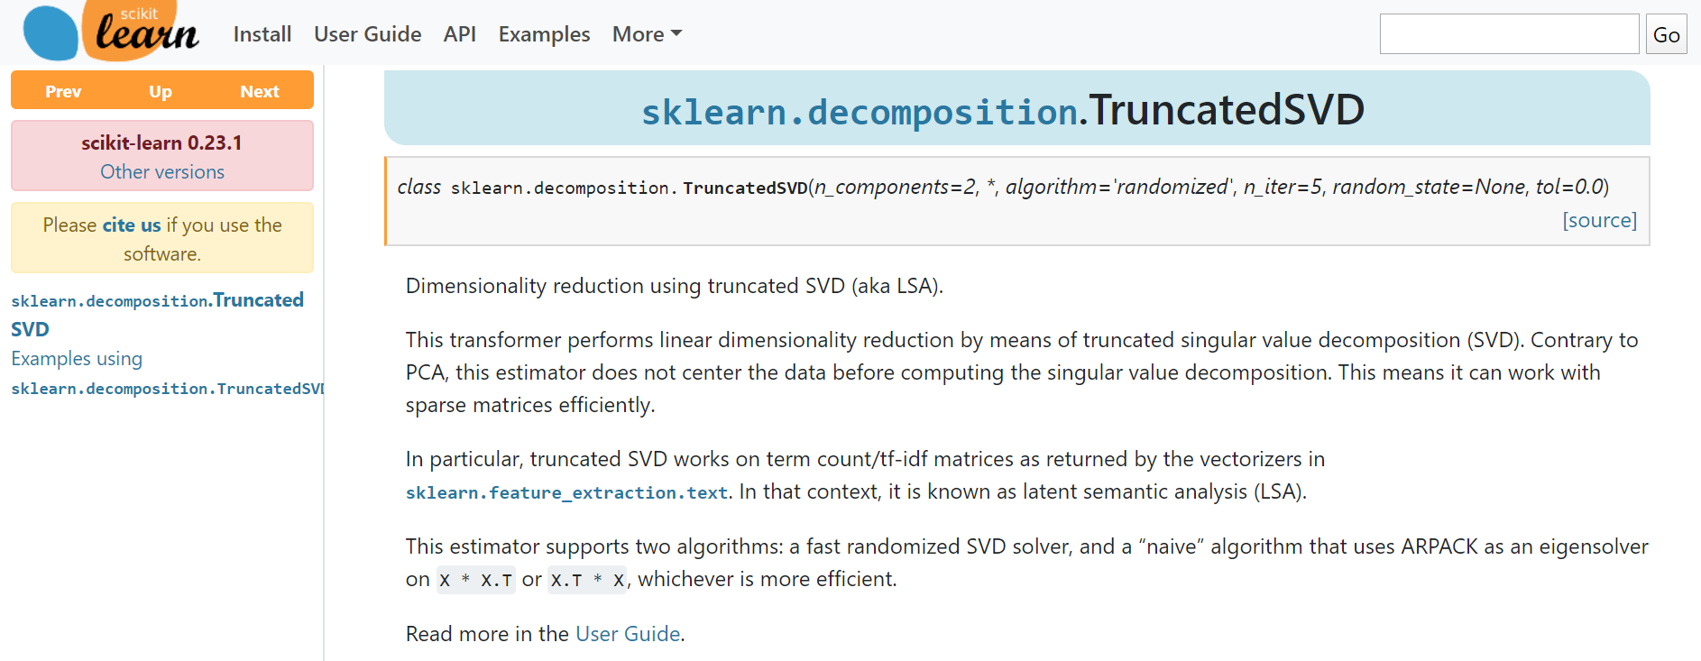

Slide 27
PCA without centering the data

Slide 28
Vector Space model
Since the content of tweets is mostly unstructured, the Vector Space model must be used to convert it into structured data and obtain useful information.
BOW (Bag of word)
WORD2Vec

Slide 29
Advantages of BOW Models
Very simple to understand and implement

Slide 30
Disadvantages of BOW Models
high dimensional feature vector
it assumes all words are independent of each other.
highly sparse vectors as there is nonzero value in dimensions

Slide 31
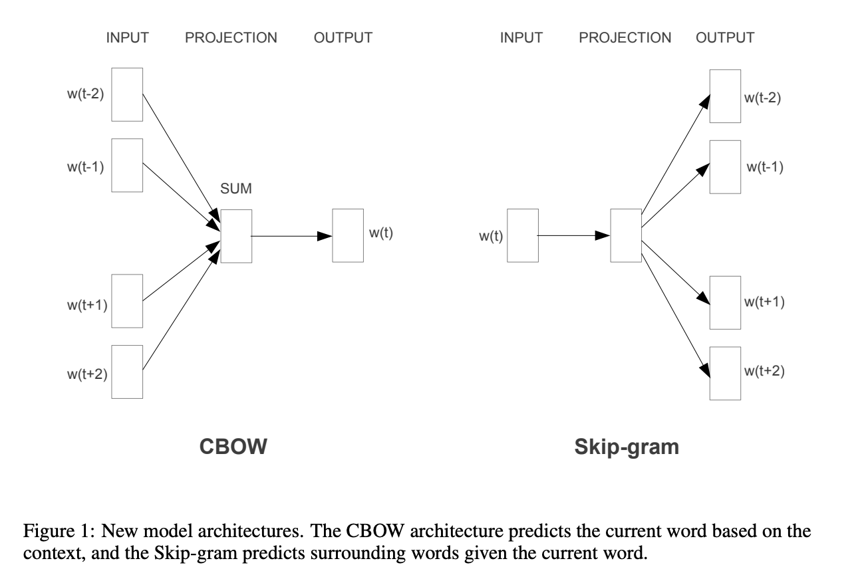
Word2Vec & Doc2Vec

Slide 32
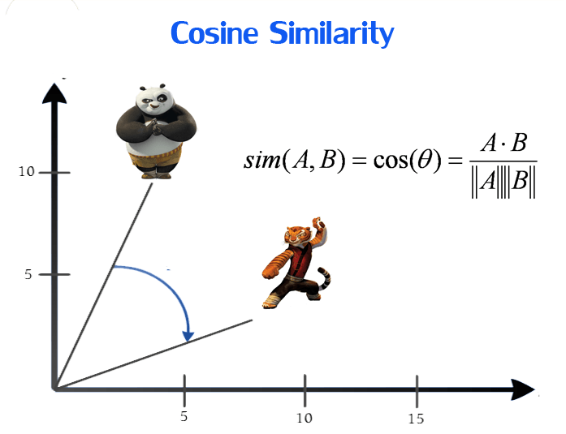
It is developed by Tomas Mikolov in 2013 at Google.
Objective is to have words with similar context occupy close spatial positions.
E.G. ‘good’ and ‘great’ should get a similarity close to 1 when calculating cosine similarity.

Slide 33
CBOW
CBOW method takes the context of each word as the input and tries to predict the word corresponding to the context.
E.G. Sentence: “Have a good day”
We use the one hot encoding of the input word and measure the error calculated by our loss fuction compared to one hot encoding of the target word (day).

Slide 34
Skip-gram
We input the target word into the network. The model outputs C probability distributions.
E.G. “Have a good day”, inputting “good” and the model would calculate the probability of occurrence of have & day.

Slide 35
HAVE
A
GOOD
DAY
CBOW
HAVE
A
GOOD
DAY
Skip-gram
Input
Predict

Slide 36
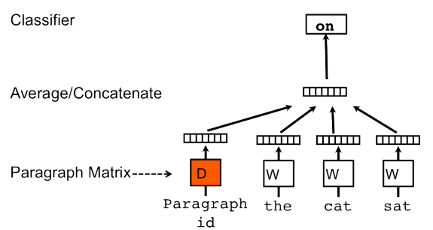
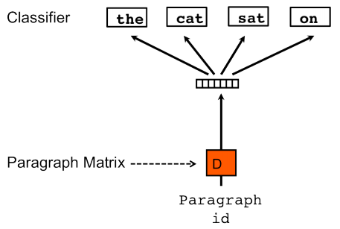
Similar to Skip-gram
Doc2Vec
Similar to CBOW

Slide 37
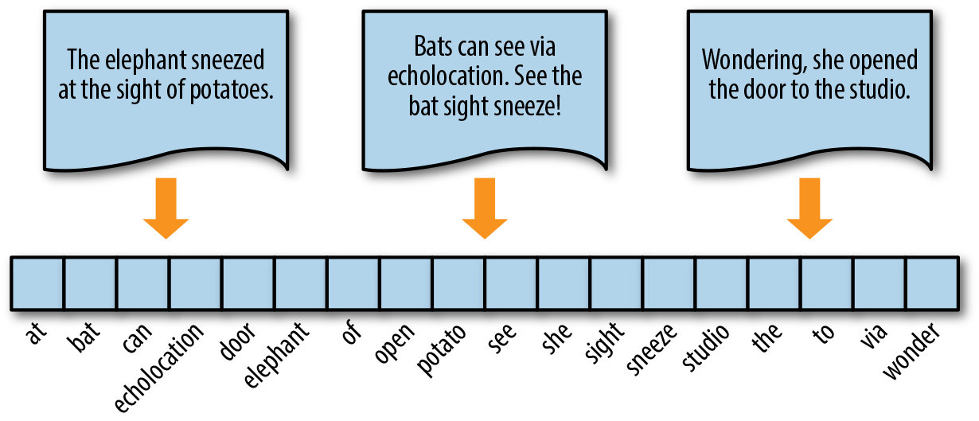

Data Vectorization (Implementation)

Slide 38
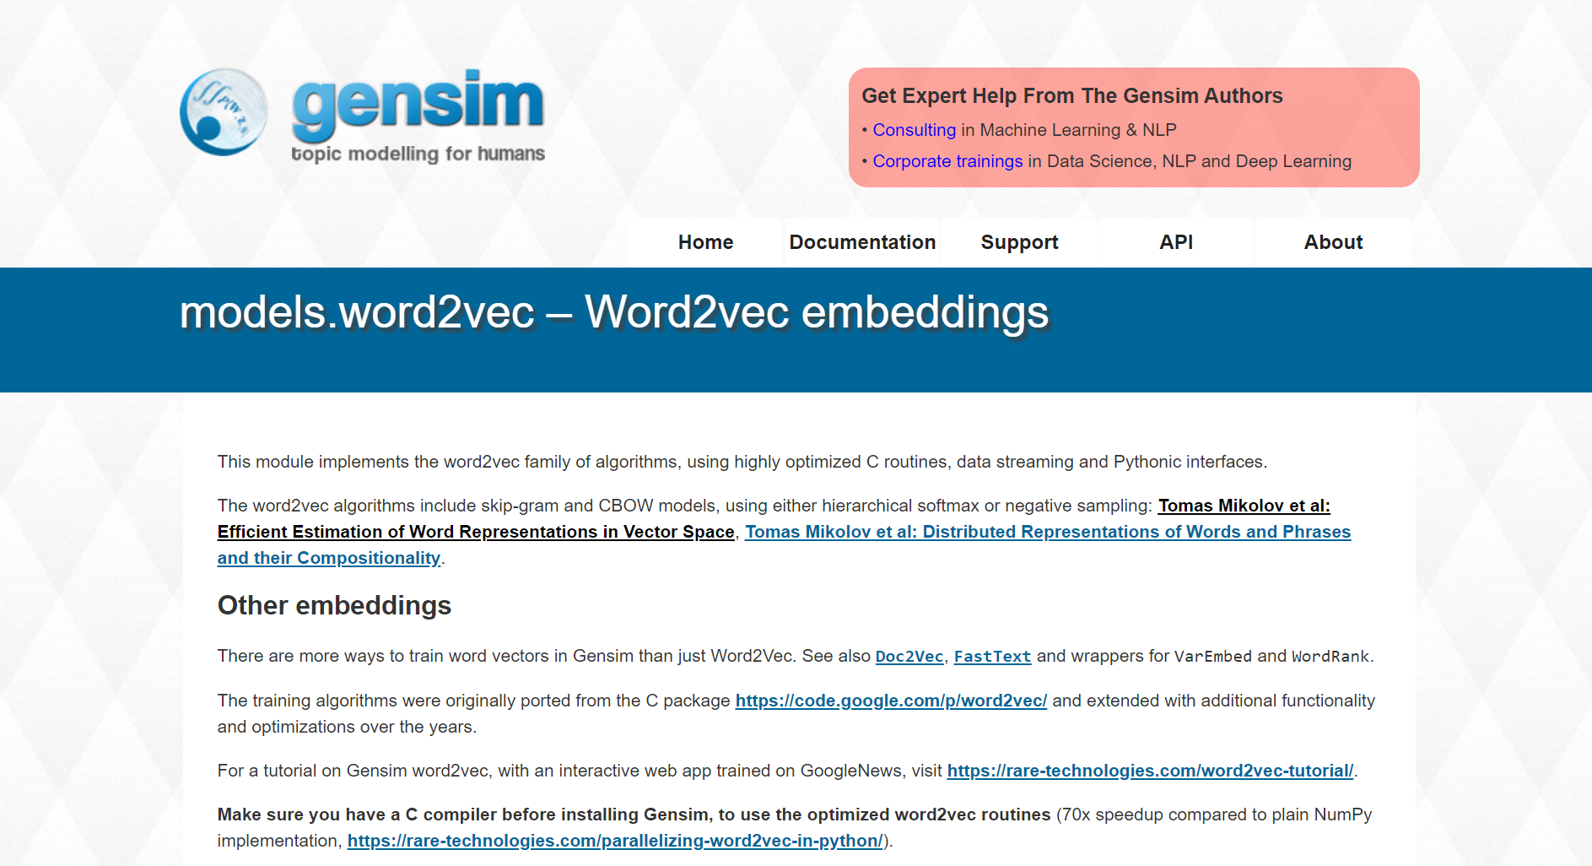

Slide 39
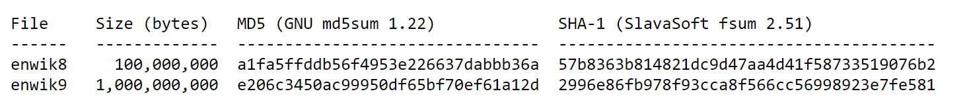
Text8 dataset
from the English Wikipedia dump on Mar. 3, 2006.
UTF-8 encoded
enwik9 contains
243,426 article titles

Slide 40
Model Parameters
vector_size=50
Epochs=100

Slide 41
Combine data with other online source
Tweet text splitting (by RT, original text, retweet text)
Stop words removing (Only for BOW Method)
Dimension Reduction (Truncated SVD)
Vectorization (tfidf, Doc2Vec Approach)

Slide 42
Dataset Overview
TWEETS
RT @SteveSGoddard: The @nytimes was thrilled by Obama talking to Communist dictator Castro, and horrified by Trump talking to the elected l??e
Oops. RT @thehill: Trump breaks decades of US protocol with phone call to Taiwan leader https://t.co/YU2x04PhV7 https://t.co/2WXDViC7lK
Donald Trump? call with Taiwan president was no surprise: Official https://t.co/F8TzF1U9UPps
RT @ShubieDobee: So, Trump spoke to the president of Taiwan.
Trumps wants to build hotel and resorts in Taiwan.
Does anyone see a CONFLICT???n
Same mental midgets that defended Castro https://t.co/Nrt2yCb7M0 are mad Trump talked to Taiwan
RT @guardian: Trump's Taiwan phone call preceded by hotel development inquiry https://t.co/nqKTBVr3eK
RT @laseptiemewilay: 1-About Trump's phone call to Taiwan's. First, it's a major diplomatic incident. Second, as part of the US normalizati??e
Trump Speaks With Taiwan? Leader, an Affront to China https://t.co/AEeTzcpNS7 #SouthChinaSea #AsiaPacificnd
RT @RawStory: REVEALED: Trump Organization eyes Taiwan for newest luxury resort location https://t.co/RuaFG6YTub https://t.co/je0TE0LXbE
RT @terrymendozer: Obama will not release info to congress on refugees deal and y'all worried about a congratulatory call from our ally Tai??e
RT @thehill: Trump says Taiwan leader called him, though Taiwan paper says Trump staffer arranged call https://t.co/QYprHM5BLs https://t.co??e
RT @_Makada_: Hoaxing media says Trump isn't allowed to talk to Taiwan, but Obama can sell them $1.83 billion worth of weapons?
https://t.??:
RT @kurteichenwald: I wonder how conservs will respond to Trump having just reversed a China/Taiwan policy put in place by Reagan &amp; honored??
RT @realwesmyers: Can you believe Donald Trump took a call from Taiwan without having them donate to his private foundation first?
RT @terrymendozer: Obama will not release info to congress on refugees deal and y'all worried about a congratulatory call from our ally Tai??e
@MarkJKremer @realDonaldTrump MSM continues to lie lie lie. Taiwan called Trump. He didn't call Taiwan.
RT @EricLiptonNYT: Trump Org: "we are not planning any expansion into Taiwan." How abt this? Great find @mega2e https://t.co/zBLAHLeJmz htt??e

Slide 43
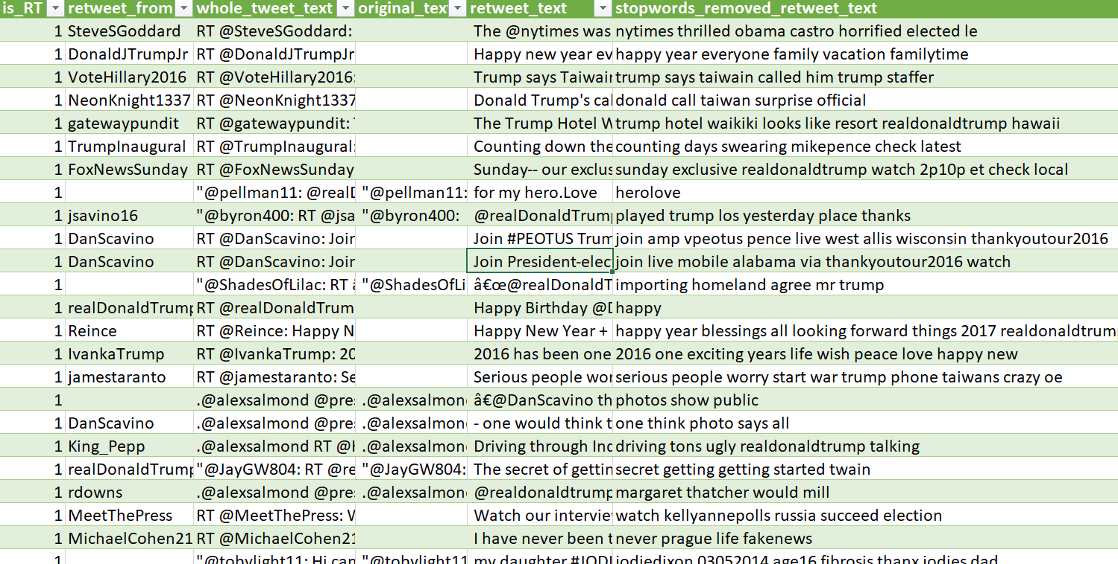

Slide 44
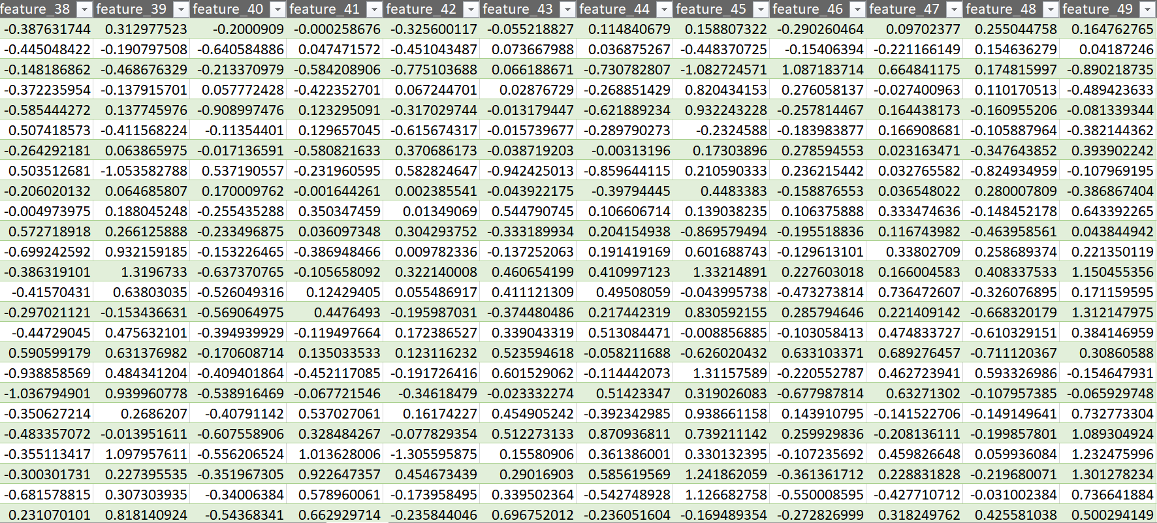

Slide 45
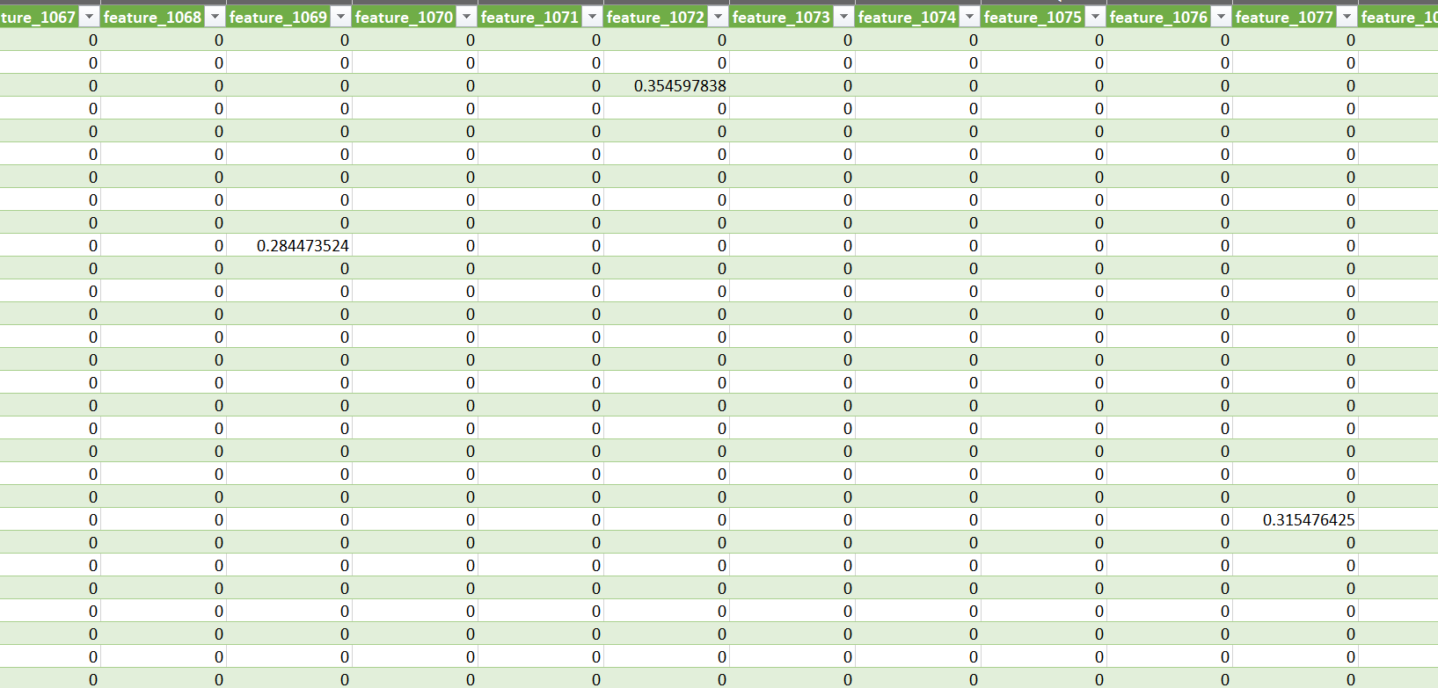

Slide 46
TF-IDF Vectorization
(610 * 2425)
TF-IDF Vectorization
+ Truncated SVD
(610 * 500)
Doc2Vec
(Tweet Only)
(610 * 50)
Doc2Vec
+ text8
(610 * 50)

Slide 47
Doc2Vec
(30693 * 50)
TF-IDF
(30693 * 10435)

Slide 48
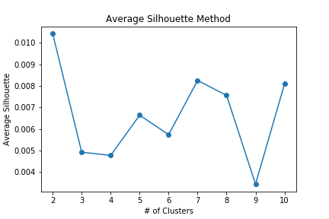
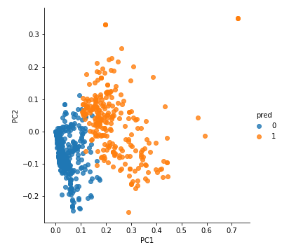
Modeling
Retweet data: Analyzed by K-Means, DBSCAN, OneClass SVM
Notes:
After vectorizing the text, we begin to build our clustering model. Because our data has no label, we try different unsupervised learning algorithms, such as k-means, DBSCAN and OneClass SVM. As we previously mentioned, we use two different methods to vectorize the text, which is tf-idf method and doc2vec. However, here I will take tf-idf method for example to simplify the illustration.
First, we conduct K-Means. In order to decide the clustering number K, we plot the average silhouette for different K. From the silhouette plot, we choose the best K to be 2. Then, we visualize the clustering result. Here, the text is separated into two groups, however the distance between them are close.

Slide 49
Check the prediction result
retweet_from | retweet_text | k_means_tfidf_pred
TeamTrump | .@HillaryClinton is RAISING your taxes to a disastrous level… | 0
DanScavino | Join #PEOTUS Trump & #VPEOTUS Pence live in West Allis, Wisconsin! | 0
DRUDGE_REPORT | Obama Refers to Himself 119 Times During Hillary Nominating Speech... | 0
JoeNBC | Explosive Trump attack Cosby Weiner Trump camp ante | 1
guardiannews | Trump's Taiwan phone call preceded by hotel development inquiry | 1
nytimes | Donald spoke telephone Taiwan leader could rift China | 1
Support Trump’s account
Protest Trump’s account
Notes:
After the K-means help us cluster the data into two piles, we then want to see “how good the result is.” Here we found an interesting observation, for those retweet messages which is clustered into group 0 (that is the top 3 rows in the table), when we check the standpoint (point of view) of these account, we found that group 0’s accounts are support Trump’s account. That means, these accounts are managed by those who support Trump. On the contrary, group 1 are the protest Trump’s account. From this observation, we can conclude that K-means perform well in our dataset especially when we use tf-idf method to vectorize the tweets.

Slide 50
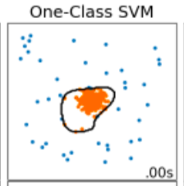
One-Class SVM
Find the outliers(abnormal points)
Concept similar to our task
Notes:
Aside from K-means, we also try DBSCAN and OneClass SVM. OneClass SVM is usually used in anomaly detection. The mission is to find the outlier or we say, the abnormal points. We try OneClass SVM method because the concept of OneClass SVM fits the characteristic of our dataset. In our retweet data, most of the tweets are from support Trump’s account. Only a few of them are from protest Trump’s account. So, we try to find these abnormal accounts by using OneClass SVM.

Slide 51
Model Evaluation
Vectorization Methods | Clustering Methods | TP | FP | TN | FN | Accuracy | Recall | Precision | F1-Score
Tf-idf | K-Means | 23 | 15 | 191 | 5 | 0.91 | 0.82 | 0.61 | 0.70
 | OneClass SVM | 21 | 73 | 133 | 7 | 0.66 | 0.75 | 0.22 | 0.34
 | DBSCAN | NAN | NAN | NAN | NAN | NAN | NAN | NAN | NAN
Tf-idf with truncated SVD | K-Means | 4 | 18 | 188 | 24 | 0.82 | 0.14 | 0.18 | 0.16
 | OneClass SVM | 10 | 94 | 112 | 18 | 0.52 | 0.36 | 0.10 | 0.15
 | DBSCAN | 10 | 15 | 191 | 18 | 0.86 | 0.36 | 0.40 | 0.38
Doc2vec | K-Means | 7 | 4 | 202 | 21 | 0.89 | 0.25 | 0.64 | 0.36
 | OneClass SVM | 4 | 104 | 102 | 24 | 0.45 | 0.14 | 0.04 | 0.06
 | DBSCAN | 14 | 14 | 192 | 14 | 0.88 | 0.50 | 0.50 | 0.50
Doc2vec with text 8 | K-Means | 18 | 83 | 123 | 10 | 0.60 | 0.64 | 0.18 | 0.28
 | OneClass SVM | 20 | 101 | 105 | 8 | 0.53 | 0.71 | 0.17 | 0.27
 | DBSCAN | 12 | 5 | 201 | 16 | 0.91 | 0.43 | 0.71 | 0.53
Better!
Better!
Notes:
Here is our model evaluation table. The total retweet data has about 600 tweets. And we label 200 of them as the ground truth and calculate the accuracy, recall, precision and f1-score. We define “Positive” as the protest trump’s account we label by ourselves, and the “Negative” is the support Trump’s account. Therefore, we would like to have a model whose recall and precision are high.
From the comparision table, we can see that K-means with tf-idf vectorization has the higher recall, precision and f1-score. That means, K-means classify the tweets well. However, if we look at the OneClass SVM in tf-idf vectorization, the recall is also quite high, but the precision drastically reduce to 0.22. This means those tweets that are labeled positive by OneClass SVM, only 22% of them are true positive. If we compare the tf-idf and tf-idf with truncated SVD, we found that the tf-idf WITHOUT truncated SVD performs better. Here we guess it is because after truncated SVD, the data projection could not separate the data well compare to the original dimension.
Also, if we compare doc2vec and doc2vec with text8, we can see that doc2vec with text8 perform much better.

Slide 52
Semi-supervised in original data
By label propagation method
Not perform well because the original data is not projected well after vectorization
Improvements
Label more data to verify the unsupervised performance
Choose a more convincing vectorization method
Notes:
In the original data, we conduct semi-supervised learning by the so-called label propagation method. How semi-supervised works is that we first label some of the data by ourselves and then put the labeled data and unlabeled data all together into the to algorithm. However, the semi-supervised clustering didn’t perform well because the features did not significantly separate the data.
Move to the final part, What we can improve is that because we are dealing with unsupervised learning. In order to evaluate the model, we need to label the data by ourselves which is really time-consuming and exhausting. Also, we need to choose a vectorization method that can truly represent the tweets. So, aside from tf-idf and doc2vec method, other method are encouraged and are worth trying.

